Slide 1


Introduction to Probabilistic Risk Assessment
Jisuk Kim
Jisuk.kim@inl.gov

Slide 2
Contents
01 What is PRA?
02 Why do we perform PRA?
03 How to perform PRA?
\

Slide 3
01 02 03
What is PRA?
Probabilistic Risk Assessment
The chance of injury or loss resulting from exposure to a source of danger
Likelihood of occurrence of the given adverse event
Magnitude(or severity) of the adverse event
Risk = Likelihood X Magnitude(or Severity)
[Probabilistic Safety Assessment, Reliability and Safety Engineering]

Slide 4
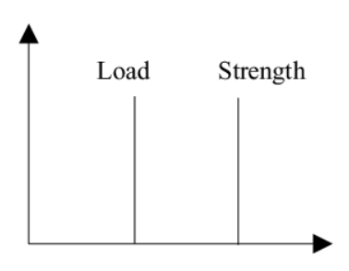
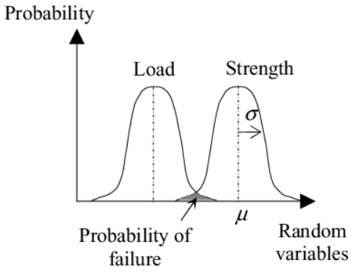
01 02 03
What is PRA?
Probabilistic Risk Assessment
Deterministic
to demonstrate that a facility is tolerant to identified faults/hazards that are within the “design basis”, thereby defining the limits of safe operation.
Probabilistic
to provide a realistic estimate of the risk presented by the facility. All potential credible accidents are included.
[https://risktec.tuv.com/risktec-knowledge-bank/qualitative-deterministic-risk-assessment/deterministic-or-probabilistic-analysis/]
[Mustaffa, Z.B., Gelder, P.V., & Vrijling, H. (2009). A Discussion of Deterministic Vs. Probabilistic Method In Assessing Marine Pipeline Corrosions.]

Slide 5
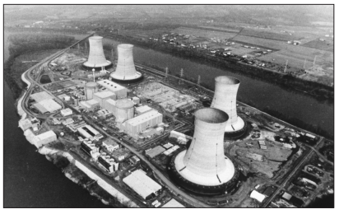

01 02 03
Why do we perform PRA?
TMI accident(1979)
A small LOCA resulting from a combination of human factors and mechanical failure.
1) Secondary cooling system failed
Pressurizer
Relief valve
X
2) Auxiliary feedwater pump also did
not work
3) The relief valve on the top of PZR open
4) The valve did not reset into a closed
position
5) Instrumentation did not alert the
state of the valve
Pressure ↑
6) Operator cannot identify the
malfunction, and stop the safety
injection
X
Safety Injection
Auxiliary
Feedwater
X
[WASH-1400 The Reactor Safety Study, USNRC]
[https://www.nrc.gov/reading-rm/doc-collections/fact-sheets/3mile-isle.html]

Slide 6
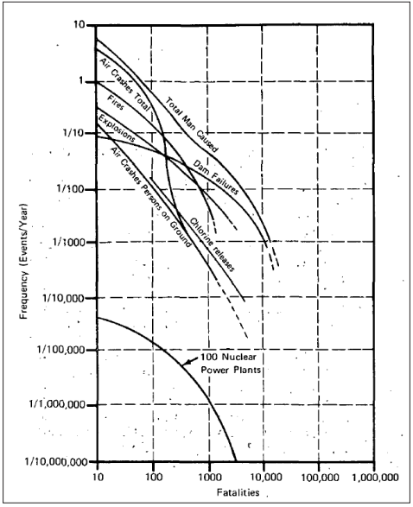
01 02 03
Why do we perform PRA?
WASH-1400
Large break LOCA vs. Small break LOCA
(LOCA: Loss of coolant accident)
In small LOCA,
The Coolant is lost at a lower rate than in Large LOCA.
The reactor vessel still maintains high pressures in small LOCA.
Operators have to deal with small-break LOCAs by using high pressure, low-volume pumps to cover and cool the reactor core.
→ Importance of Small break LOCA, compared to Large break
LOCA.
→ WASH1400 did prove prescient concerning the TMI accident
outcome.
[WASH-1400 The Reactor Safety Study, USNRC]

Slide 7
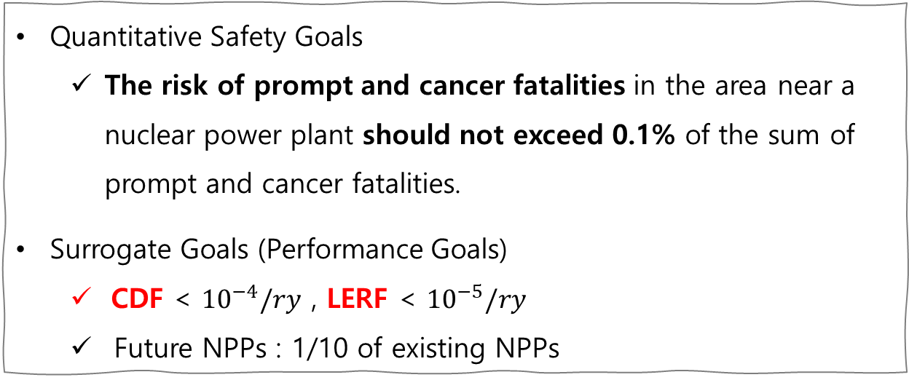
01 02 03
Why do we perform PRA?
Safety Goal
“How safe is safe enough?”
Qualitative
Safety Goal
Quantitative Safety Goals
The risk of prompt and cancer fatalities in the area near a nuclear power plant should not exceed 0.1% of the sum of prompt and cancer fatalities.
Surrogate Goals (Performance Goals)
CDF < ${10}^{−4}/ry$ , LERF < ${10}^{−5}/ry$
Future NPPs : 1/10 of existing NPPs
Quantitative Safety Goals
← The results of PRA
Surrogate Goals

Slide 8
01 02 03
Why do we perform PRA?
PRA can answer
What could go wrong? (Accident scenarios)
How likely is it? (Frequency, Probability)
What would the consequences be?

Slide 9
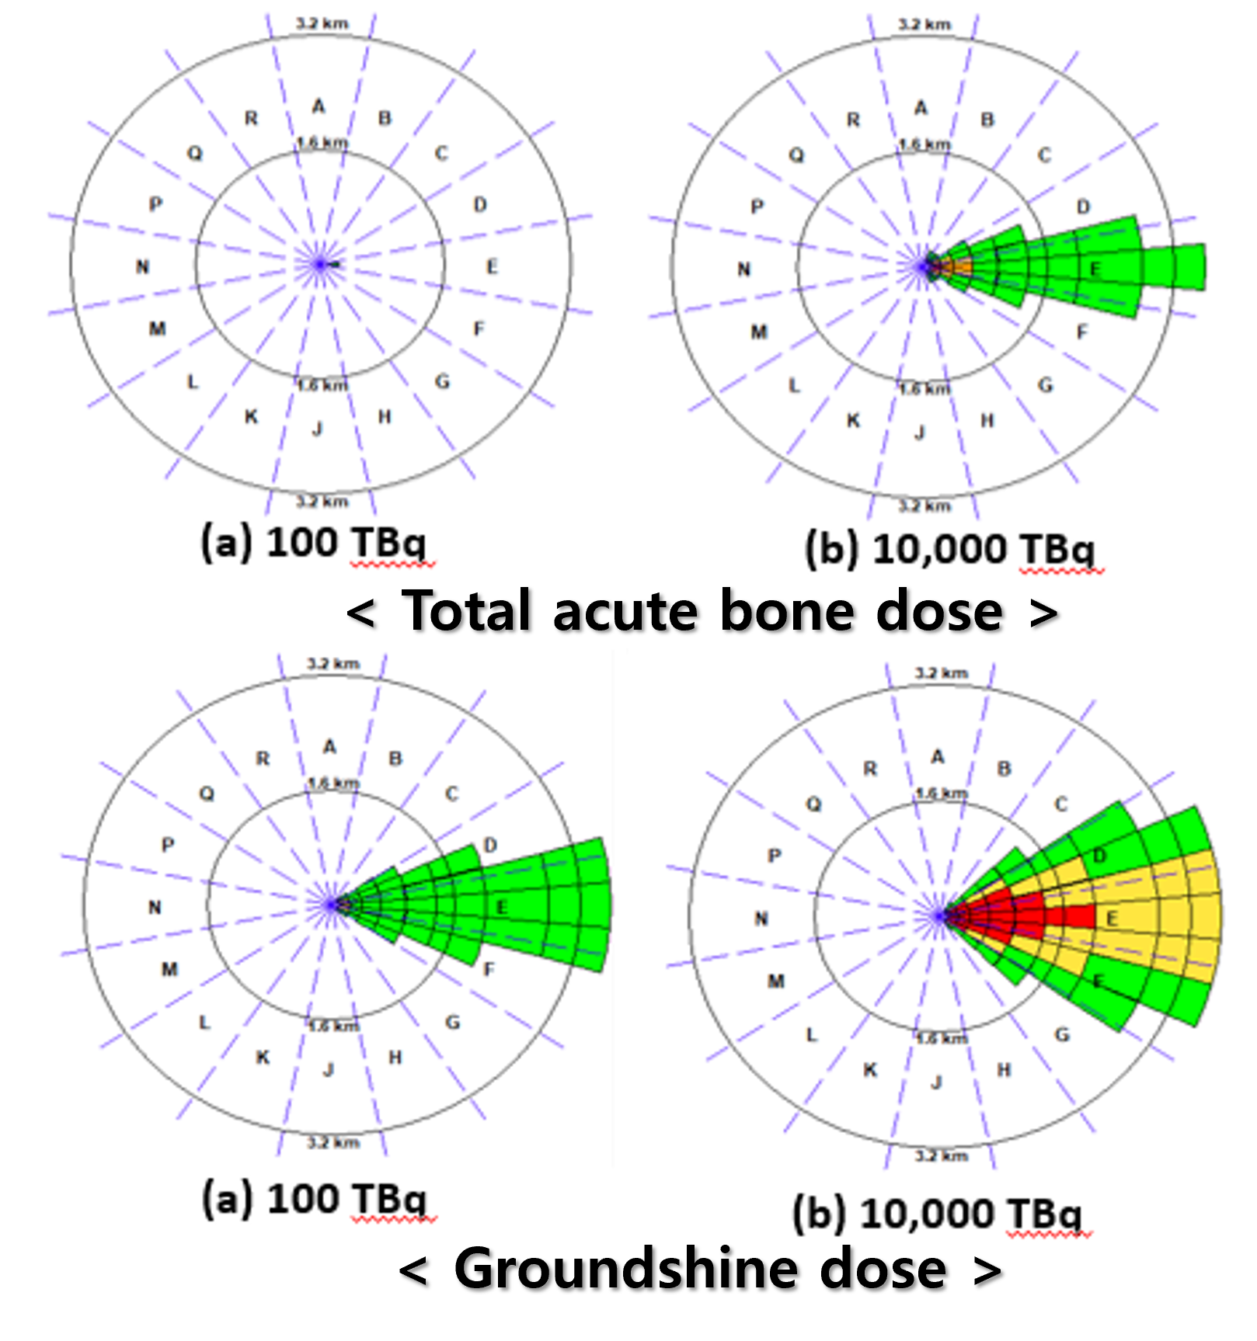
01 02 03
How to perform PRA?
Level 1 PSA
Level 2 PSA
Level 3 PSA
What could go wrong?
How likely is it?
What would
the consequences be?
Core damage frequency
(CDF)
Containment failure frequency(CFF)
/ Large Early Release Frequency(LERF)
Offsite consequence analysis(Fatality)

Slide 10
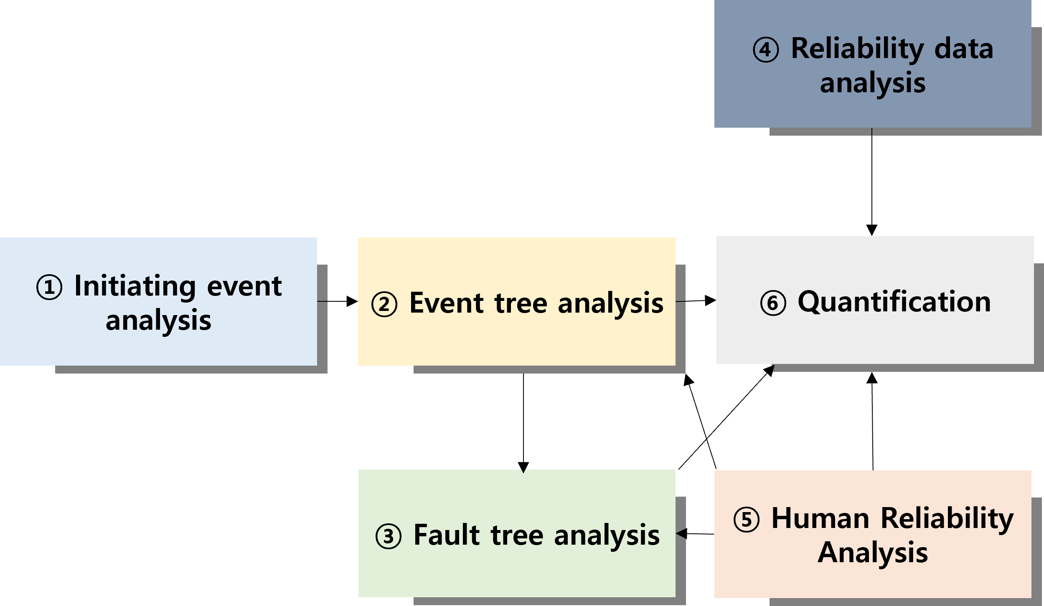
01 02 03
How to perform PRA?
Level 1 PSA procedure
③ Fault tree
A graphical depiction of how a system can fail
② Event tree A graphical depiction of a sequence of events
④ Data
Failure rate of plant equipment from operating experience
⑤ Human Reliability Analysis
Analysis and quantification of human interactions and failure
① Initiating event
Circumstances that put a plant in an off-normal condition
⑥ Quantification
Frequency, Probability
③ Fault tree

Slide 11
01 02 03
How to perform PRA?
Example
Fault tree
Event tree
Top event
Consequence
Success
Failure
Basic events
Causes
Cause
Consequences

Slide 12
01 02 03
How to perform PRA?
Safety
Injection
(SI)
Example
Reactor
trip
Cooldown
Residual
Heat removal
Control
Auxiliary
Feedwater
Control
Auxiliary
Feedwater
Isolation
faulted SG
Stop SI
ok
Injection of SI
↑
success
Isolation
Fail
↓
Reactor
trip
ok
SGTR
(Steam Generator Tube Rupture)
Human
Actions
01
Human
Actions
02
Human
Actions
03
Human
Actions
04
Human
Actions
#
Core damage
. . .
. . .

Slide 13
01 02 03
Summary
Accident scenarios, Frequency/Probability, Consequence
Initiating
Event
Analysis
Quantification
Systematic tool for analyzing complex systems with information integration
To determine the risk profile assessing weakness of a system.
Insights to improve human performance
improve the human-machine interface
Increase chances of recovery
Improve procedures
Design flaws and cost-effective ways to eliminate them in design prior to construction and operation
PRA
Event
Tree
Analysis
Human
Reliability
Analysis
Fault Tree Analysis
Reliability Data Analysis

Slide 14
Thank you for your attention

